Slide 1
WELCOME TO MY WEBSITE
USING HTML ,CSS AN

Slide 2
GROUP PARTNERS ZIAUL KADRI ANNIE AKBAR KHAN HARDIK NANDA

Slide 3
OPEN BOX BOOK STORE
HERE YOU CAN READ THE BOOKS

Slide 4
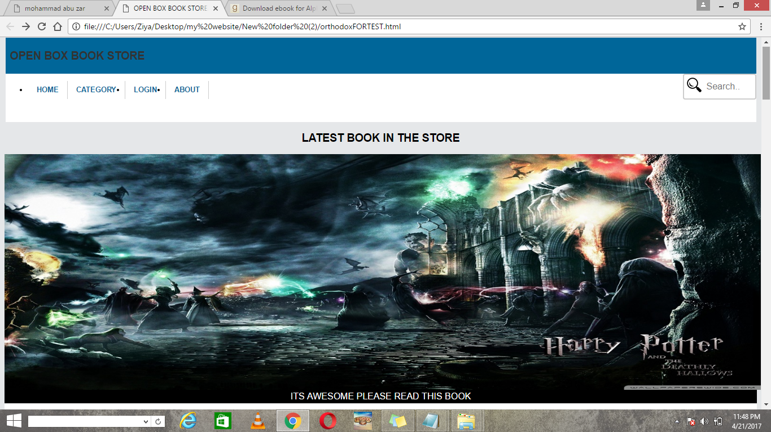
TOP VIEW OF MY WEBSITE IN THE TOP HERE THE NAVIGATION BAR WITH SEARCH BAR AND AFTER THAT HERE A IMAGE SLIDER IF YOU CLICK IN THE IMAGE SLIDER THERE OPEN A PDF FILE OF BOOK

Slide 5
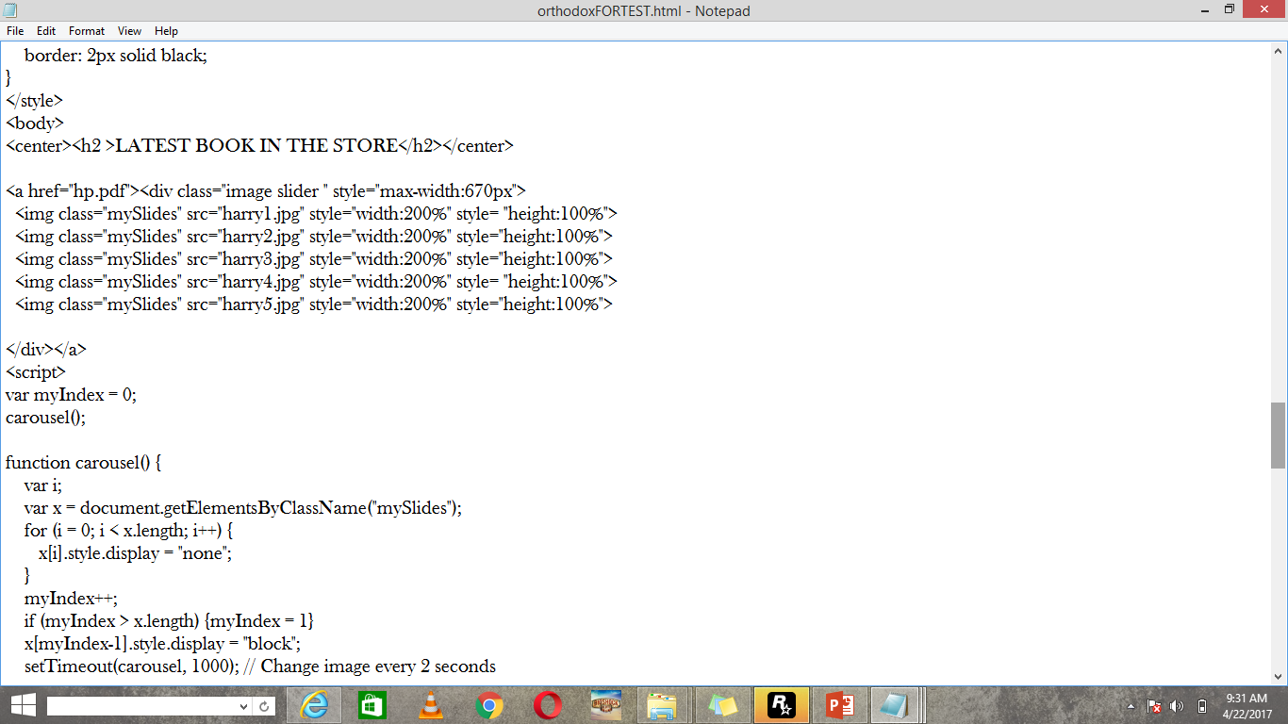
Image Slider

Slide 6
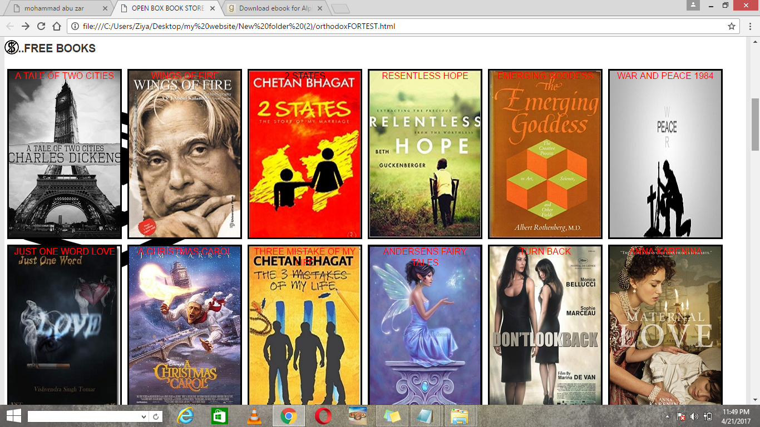
AFTER THAT HERE A CATEGORY OF FREE BOOKS WITH 12 FREE BOOKS

Slide 7
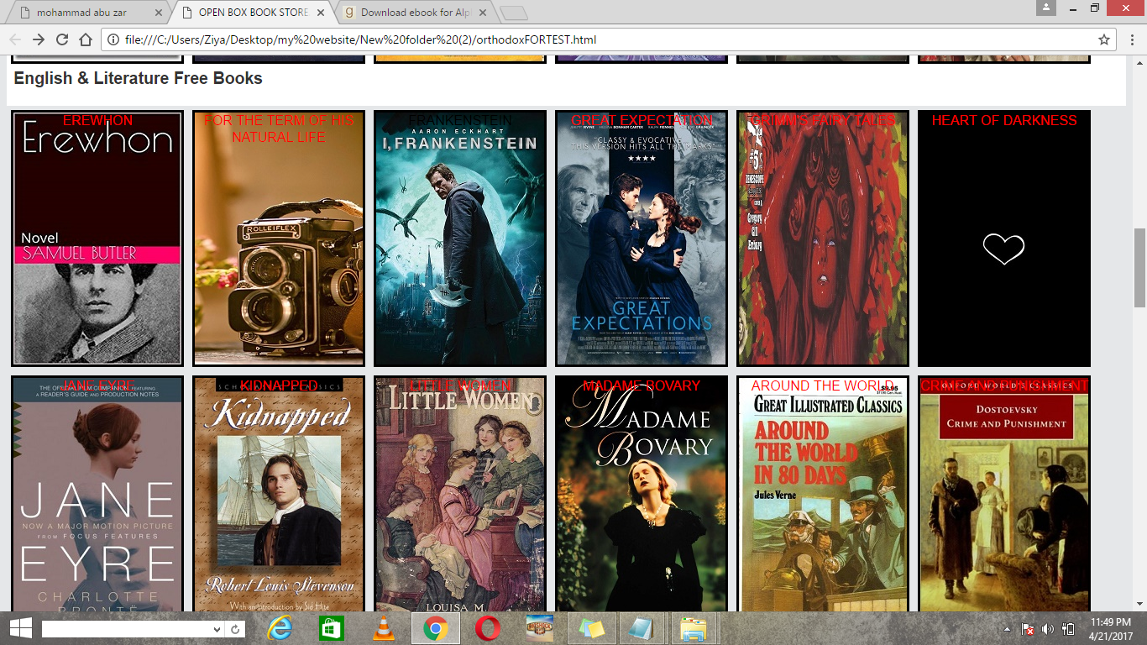
IN THIS COLUMN HERE ENGLISH AND LITERATURE FREE BOOKS

Slide 8
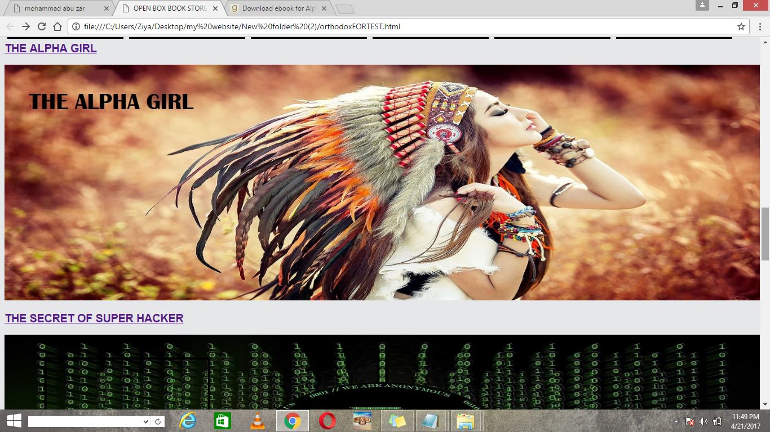
HERE A RANDOM FAMOUS BOOK OF THE TOP CHART “THE ALPHA GIRL”

Slide 9
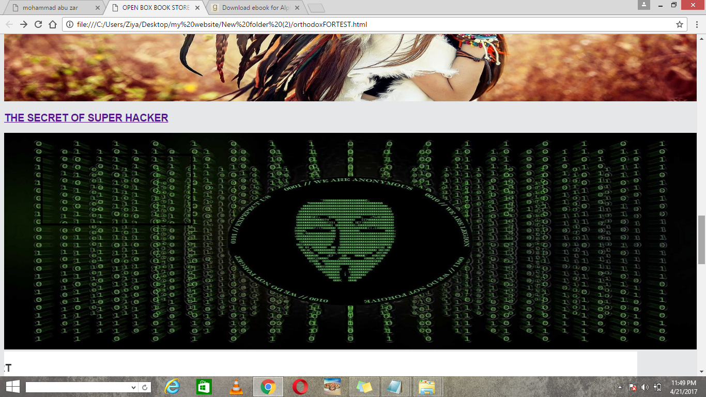
HERE THE BOOK ABOUT HACKING “THE SECRET OF SUPER HACKER”

Slide 10
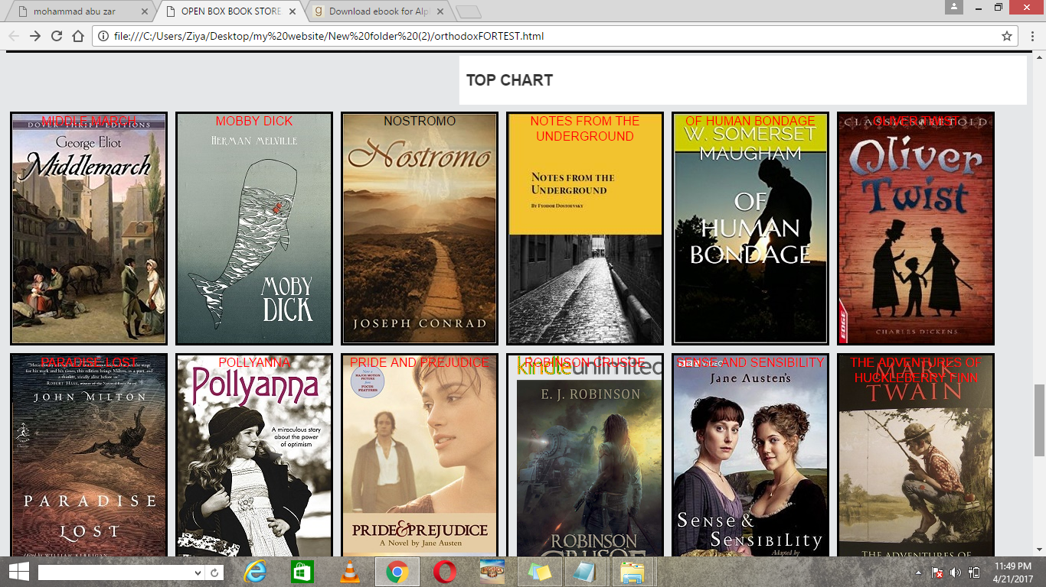
HERE THE TOP CHART OF MY WEBSITE IN THIS COLUMN THE FAMOUS BOOK OF THE YEAR

Slide 11
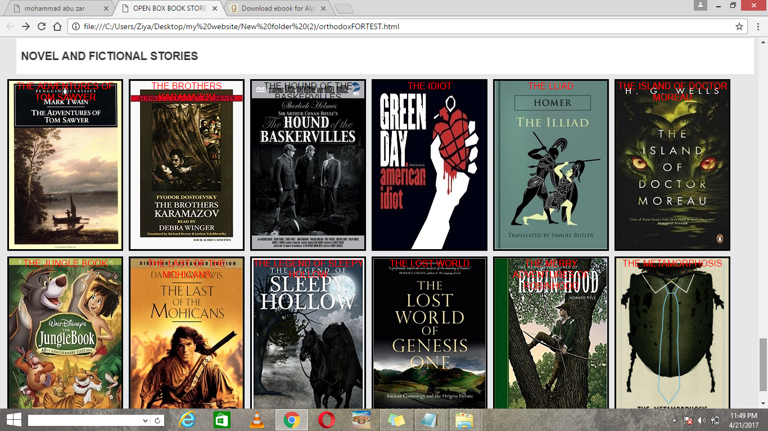
IN THIS COLUMN HERE YOU CAN READ THE NOVEL AND FICTIONAL BOOKS

Slide 12
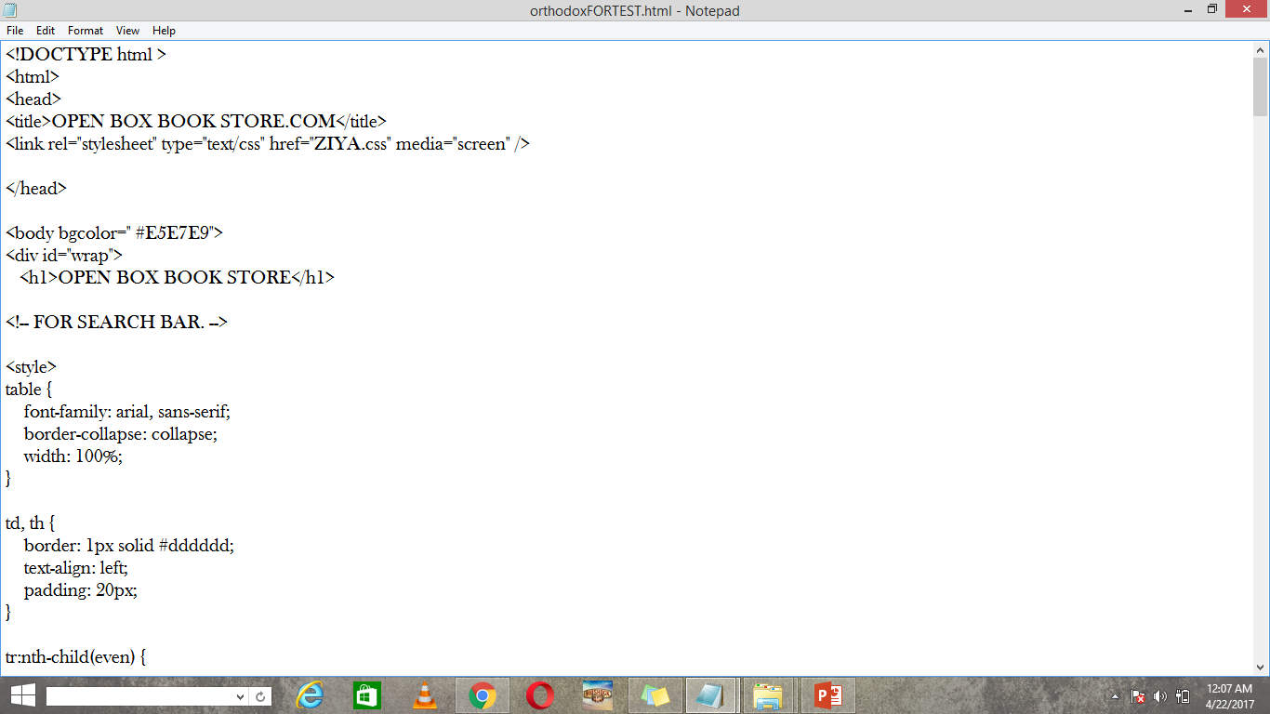
THE HTML FILE WITH CSS

Slide 13
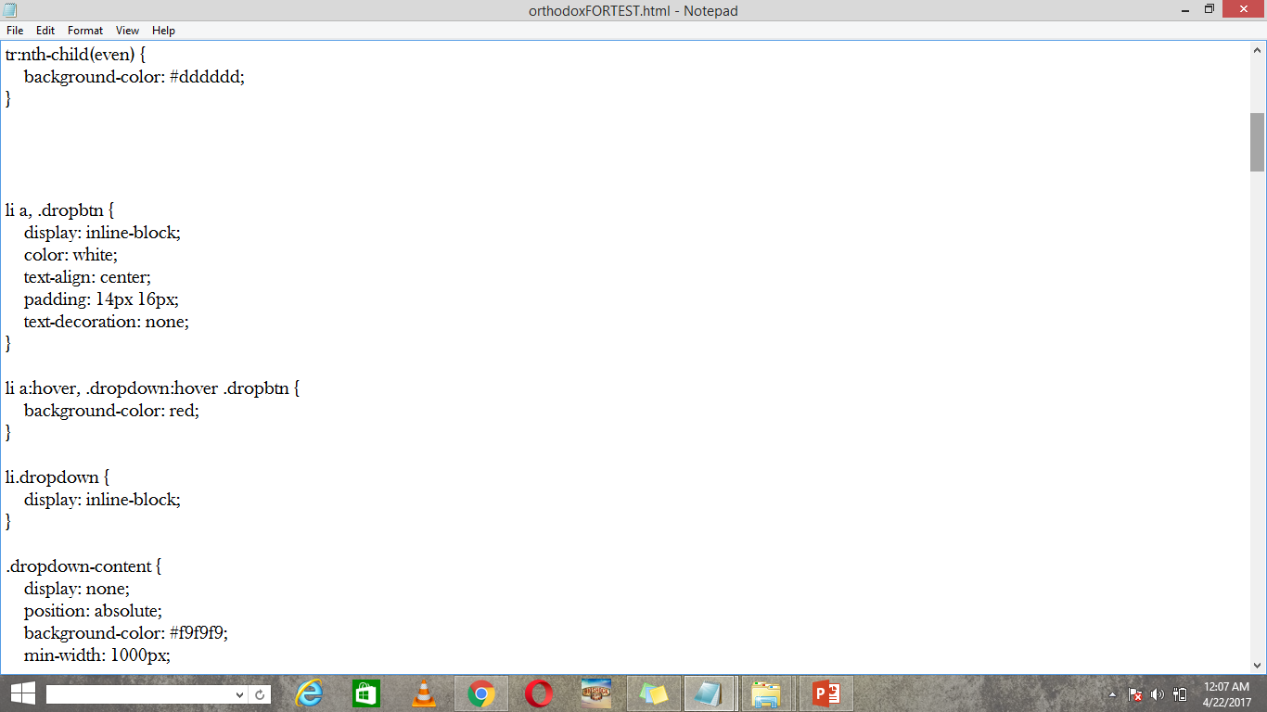
CSS FILE FOR DROPDOWN CATEGORY

Slide 14
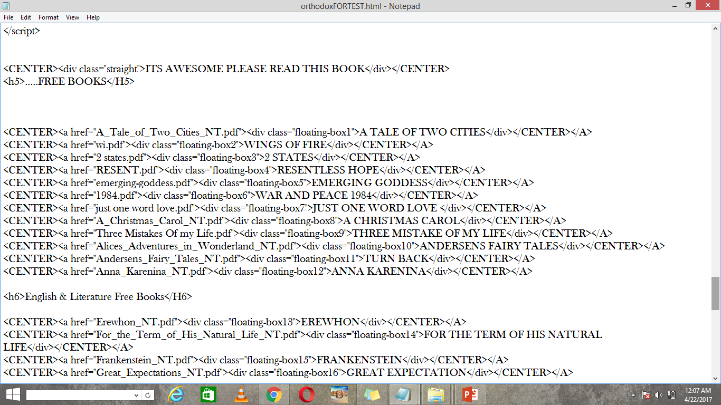
HTML FILE FOR FLOATING BOX

Slide 15
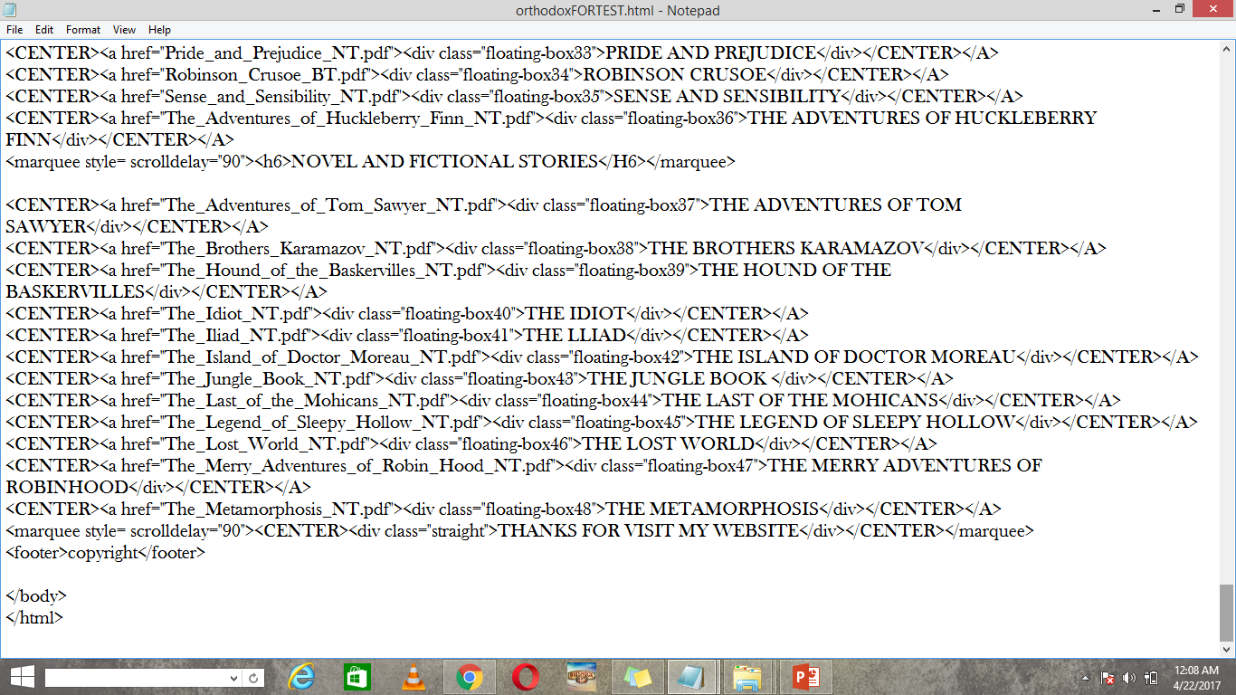
HTML FILE

Slide 16
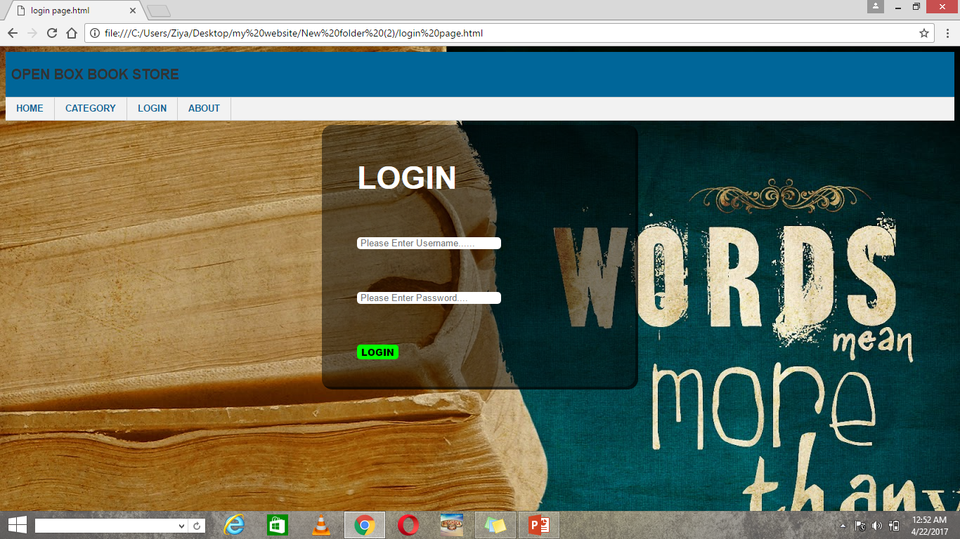
LOGIN PAGE

Slide 17
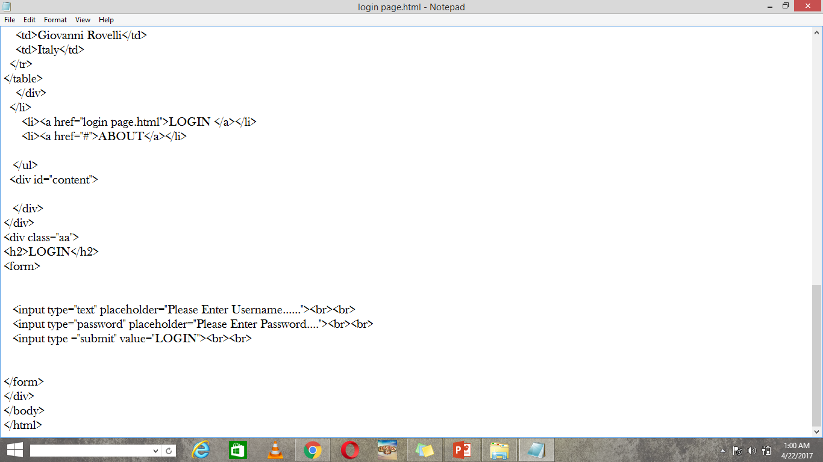
THE LOGIN PAGE

Slide 18
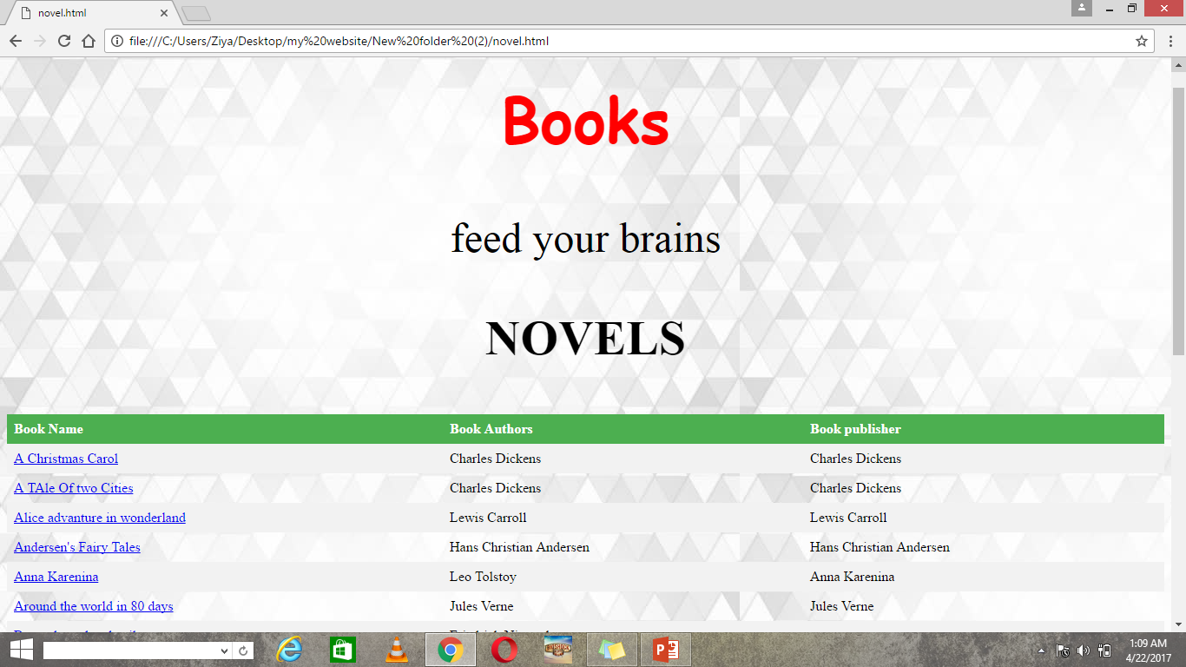
Category Novel

Slide 19
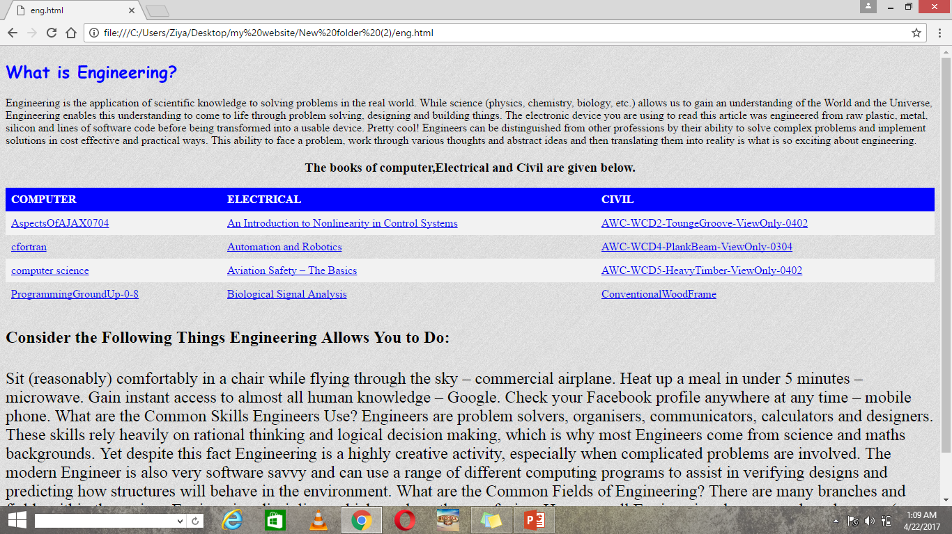
Category Engineering Books

Slide 20
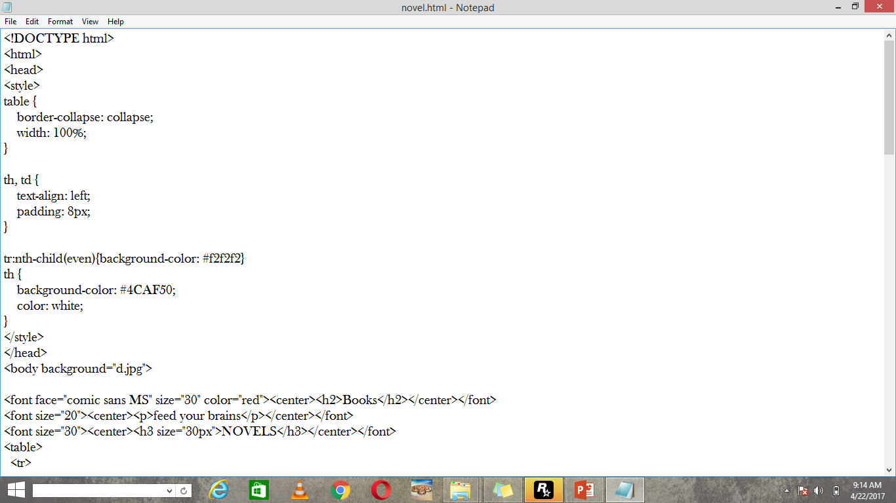
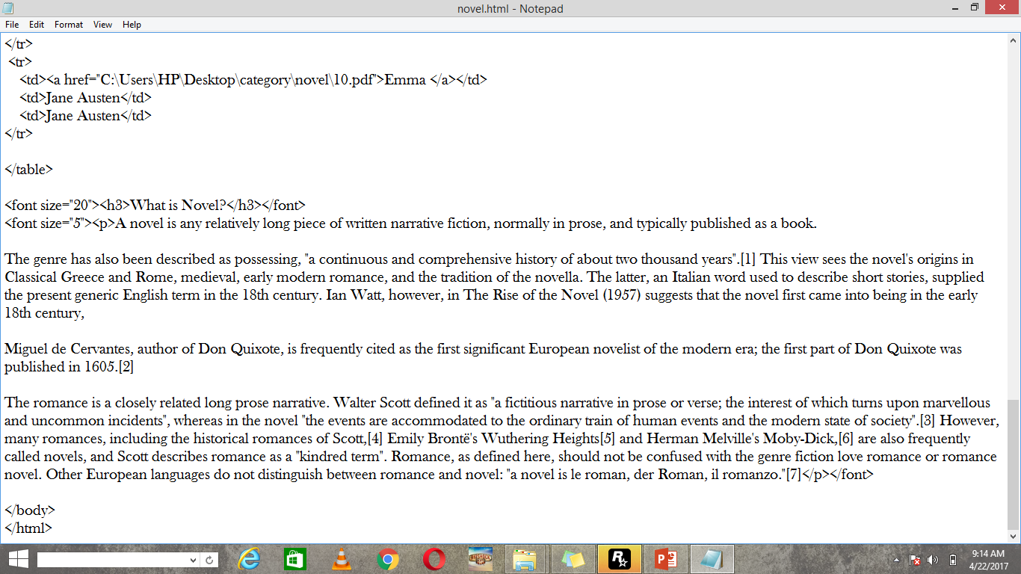
Html file of novel

Slide 21
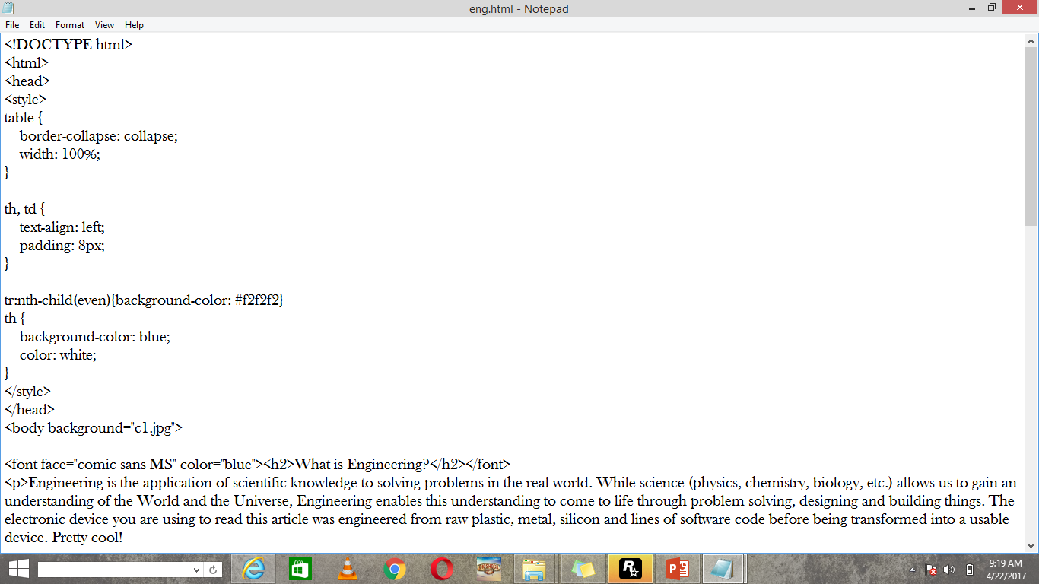
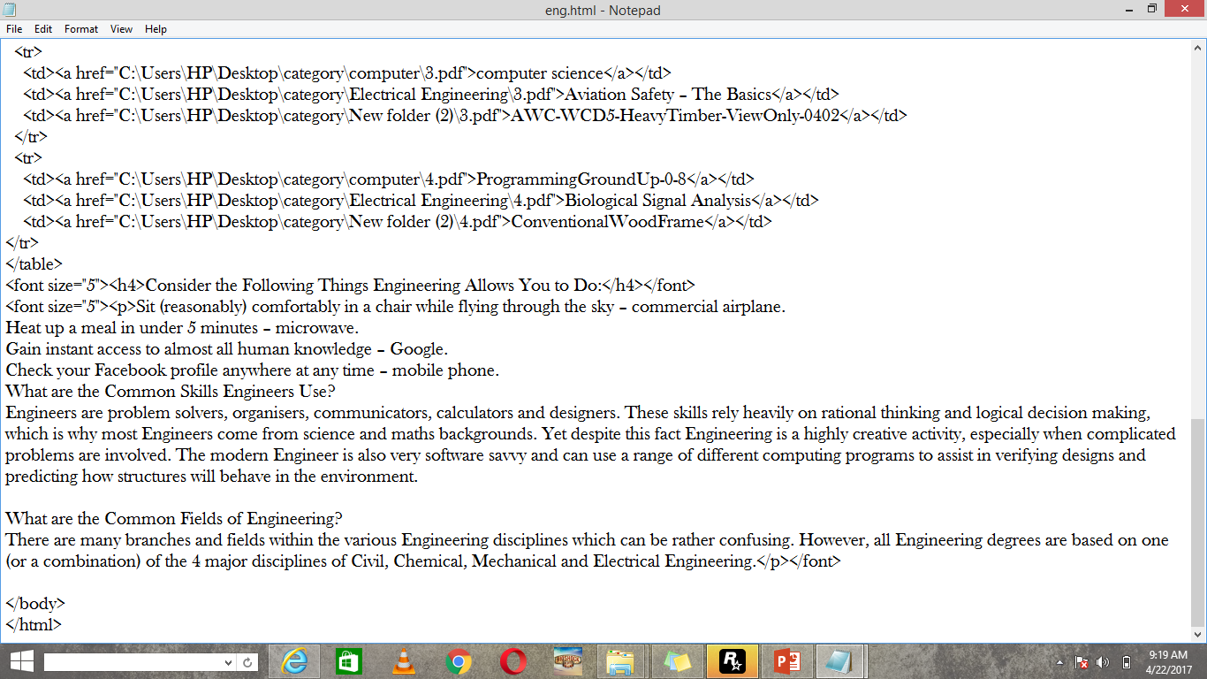
Html file of Engineering Books

Slide 22
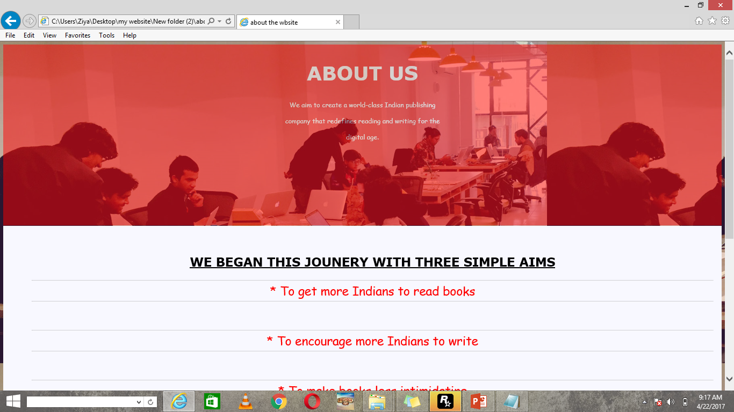
About US

Slide 23
THANK YOU

